Slide 1



Sapiat – Backtesting
Santa Clara University Practicum Team
- Abir Chakraborty

Slide 2

Objective
Compare daily portfolio returns using quarterly weights constructed using 3 covariance approaches:
Covariance of historical daily returns
Covariance matrix forecasted using Linear Regression (LR) Model
Covariance matrix forecasted using MGARCH Model

Slide 3
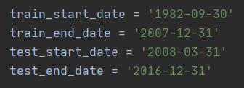
Predicting covariance elements using LR
Regressed individual covariance elements against the following independent variables:
Variances – lag 1 values
Covariances – lag 2 values
2 popular regimes: +GDP+Infl+Unemp and +GDP+Infl-Unemp
Identified significant independent variables based on results obtained
Split the dataset into training and testing period

Slide 4
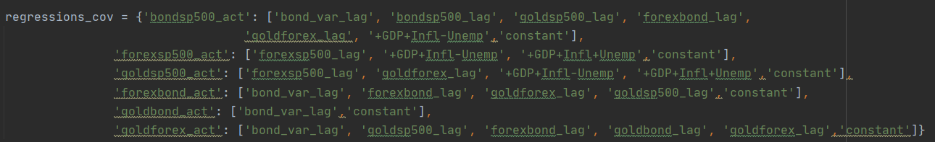
Predicting covariance elements using LR
Regressors used to predict non-diagonal covariance elements:
Log values of dependent variances or diagonal variance elements were considered to avoid negative variance prediction. Predicted values converted back to their exponential form

Slide 5
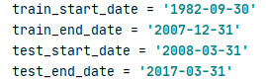
MGARCH
Conditional variances and covariances of asset returns are of considerable importance, and (co)variances are key inputs to asset allocation and risk management in financial institutions. Consequently, accurate models and forecasts of conditional variances and covariances are crucial.
We are using multivariate GARCH model to find the conditional variance and covariance among four different asset class. We are using asset daily return data for initial training period and predicting conditional variance and covariance for the next quarter, this keeps on rolling for every quarter of the test period.

Slide 6
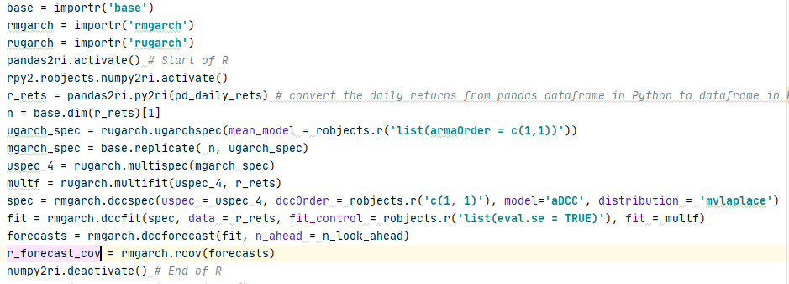
MGARCH
Within the model we are using ARMA of order (1,1). That is return on a given time period is related to the return of the previous time period and also the innovation of the previous time period.
We are using r code in python by using rpy2 package of python.

Slide 7
Methodology
Quarterly avg of daily returns for past days
Portfolio weights for each quarter and risk levels
Efficient frontier for risk-return trade off
Select weights corresponding to 3 different risk levels
Daily portfolio returns for the next quarter
Summarize and present key metrics
Quarterly Covariance matrix using 3 approaches
Daily returns for the next quarter

Slide 8
Example
Steps | Quarter ended 03/31/2008 | Quarter ended 06/30/2008
Calculating covariance matrix using historical daily returns | Covariance of past 63/252/504 daily returns | Covariance of past 63/252/504 daily returns
Covariance matrix forecasted using LR Model | Use lag values of covariance elements for training set, i.e. from 09/30/1982 to 12/31/2007 to predict covariance for quarter ending 03/31/2008 Covariance elements are calculated with a lookback of 63/252/504 daily returns | Use lag values of covariance elements for training set and previous quarter, i.e. from 09/30/1982 to 03/31/2008, to predict covariance for quarter ending 06/30/2008
Covariance matrix forecasted using MGARCH Model | Using daily returns from 09/30/1982 to 12/31/2007 , covariance matrix is predicted for quarter ending 03/31/2008 | Using daily returns from 09/30/1982 upto 03/31/3008, covariance matrix is predicted for quarter ending 06/30/2008
Weights | Compute efficient frontier for risk-return trade off for quarter ending 03/31/2008 Select weights corresponding to three different risk levels | Compute efficient frontier for risk-return trade off for quarter ending 06/30/2008 Select weights corresponding to three different risk levels
Portfolio returns | Apply weights calculated for quarter ending 03/31/2008 to daily returns from 04/01/2008 to 06/30/2008 and compute daily portfolio returns | Apply weights calculated for quarter ending 06/30/2008 to daily returns from 07/01/2008 to 09/30/2008 and compute daily portfolio returns

Slide 9
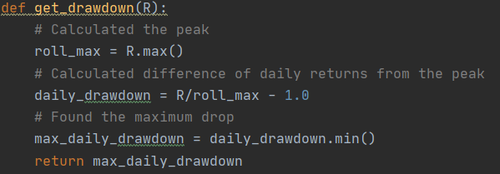
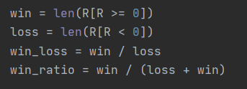
Summarizing key performance
Calculated key performance metrics for comparing portfolio returns
Drawdown
Win/Loss ratio

Slide 10

Lookback of 63 days

Slide 11
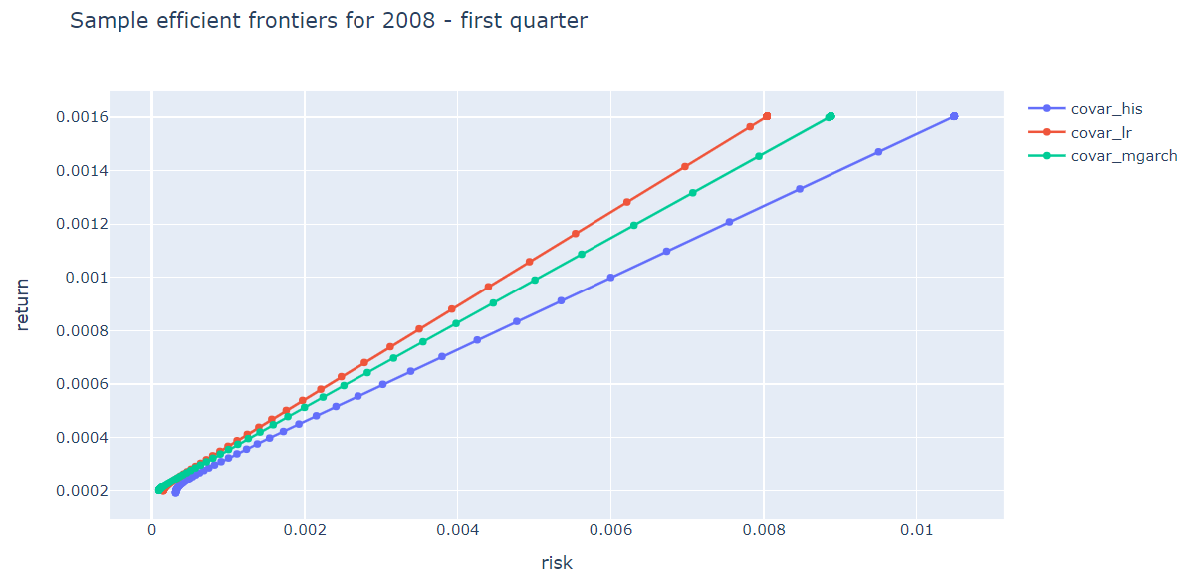
Sample Efficient frontiers

Slide 12
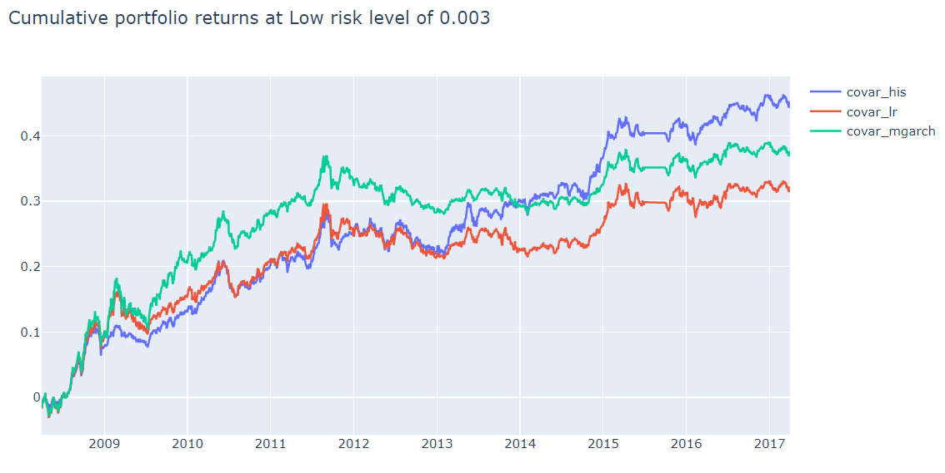
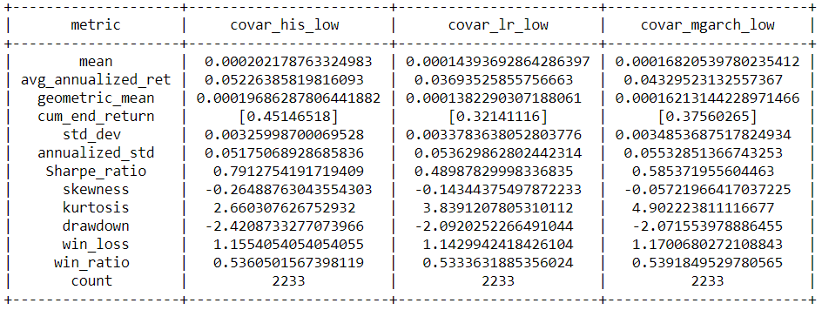
Comparing results for low risk level – 0.003

Slide 13
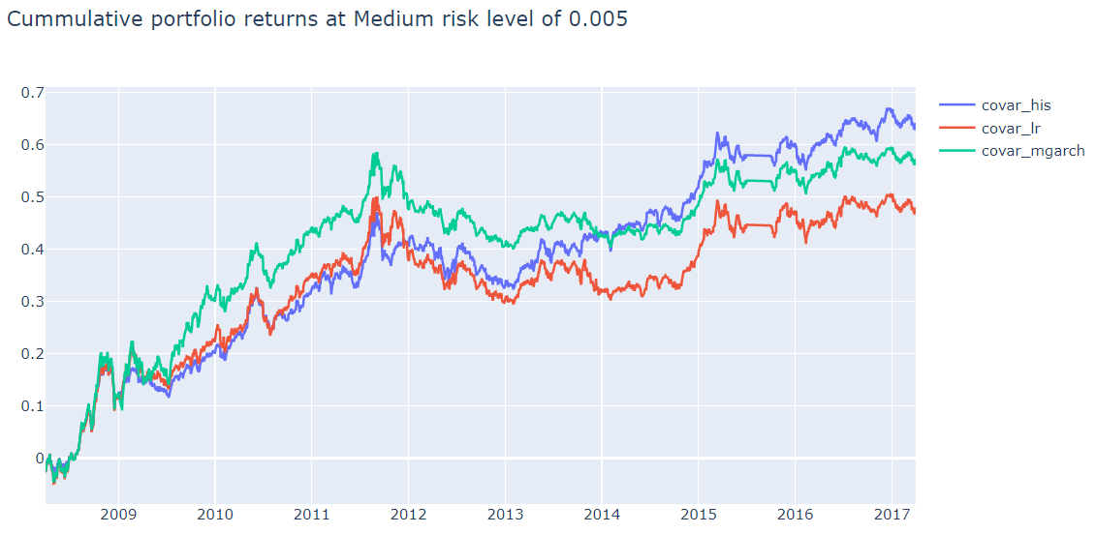
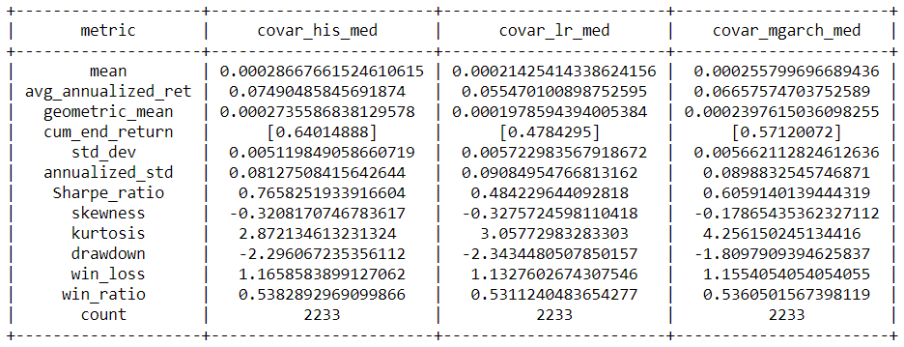
Comparing results for medium risk level – 0.005

Slide 14
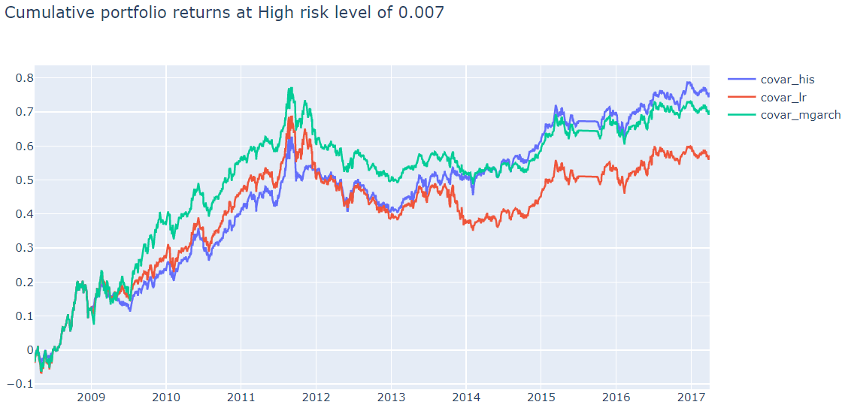
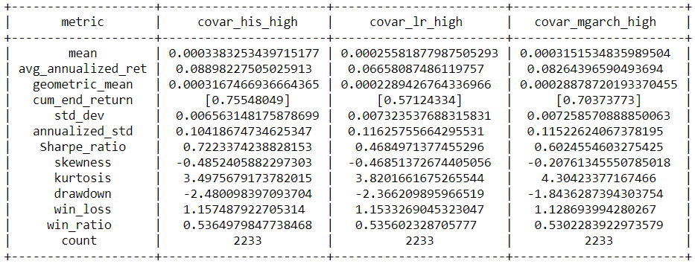
Comparing results for high risk level – 0.007

Slide 15
Lookback of 252 days

Slide 16
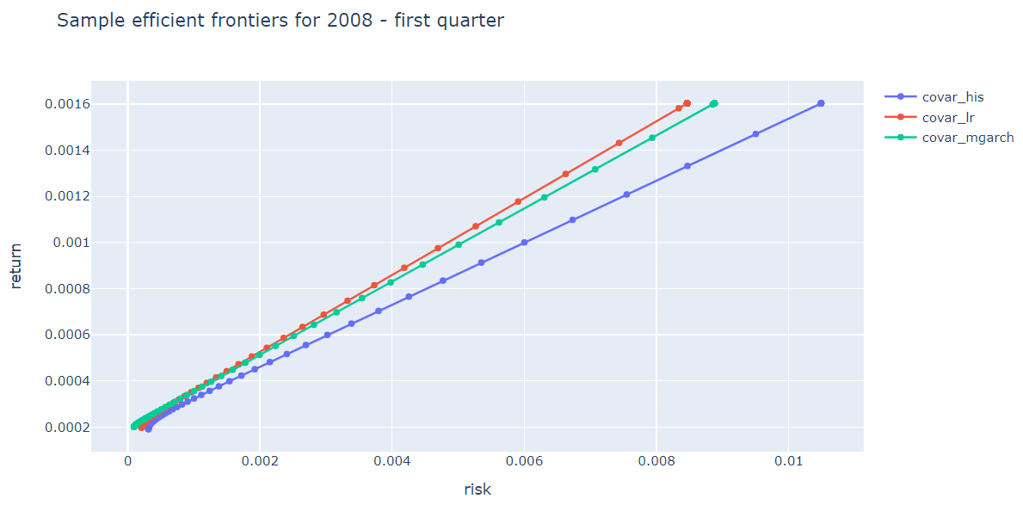
Sample Efficient frontiers

Slide 17
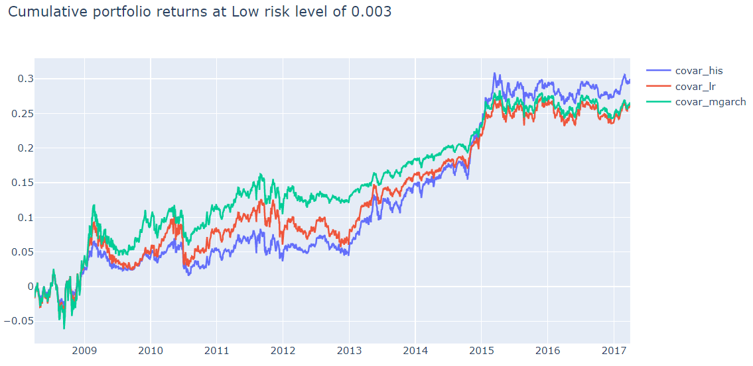
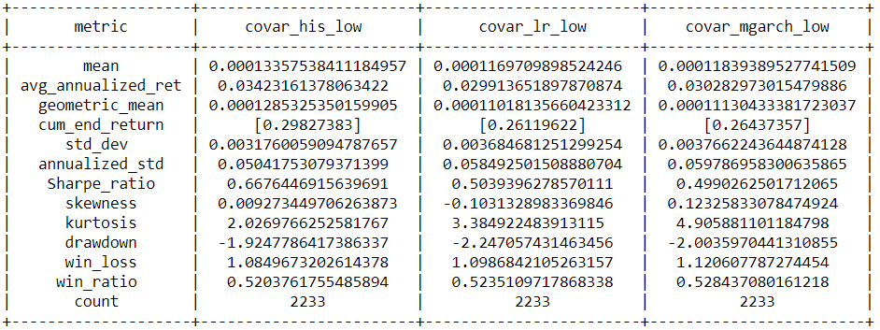
Comparing results for low risk level – 0.003

Slide 18
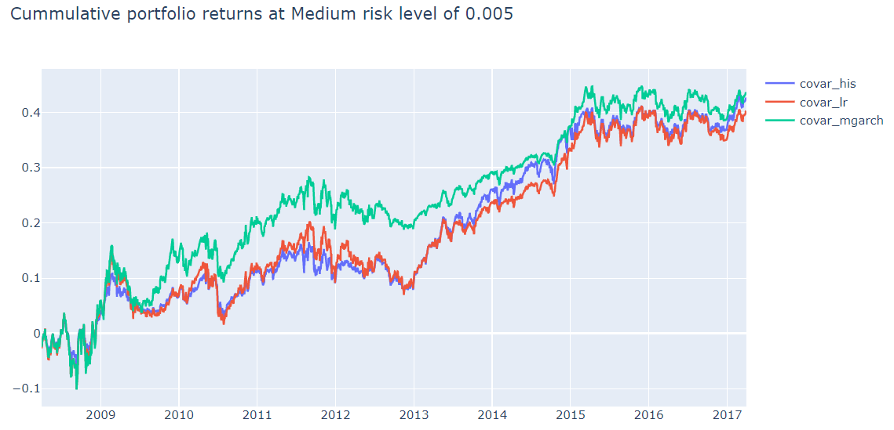
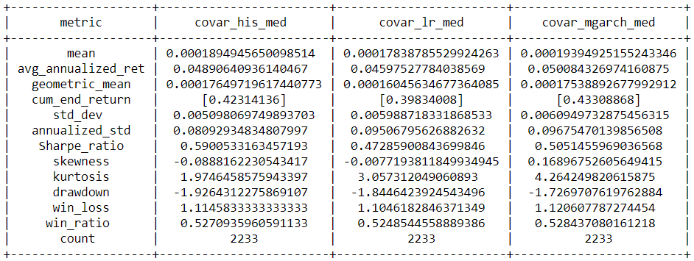
Comparing results for medium risk level – 0.005

Slide 19
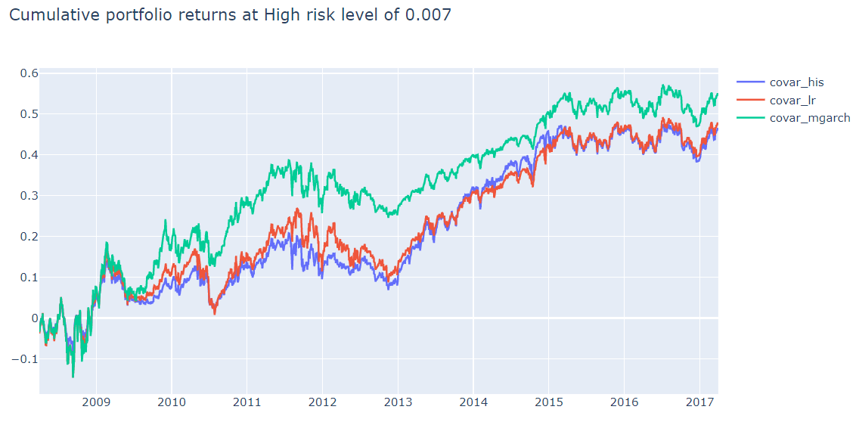
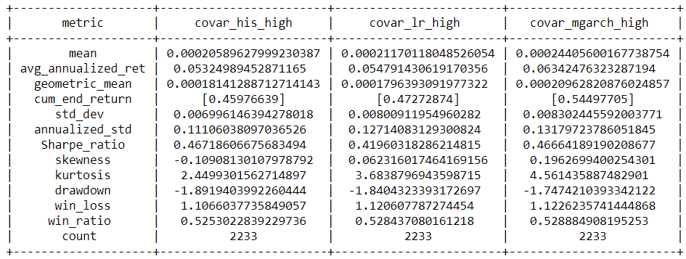
Comparing results for high risk level – 0.007

Slide 20
Lookback of 504 days

Slide 21
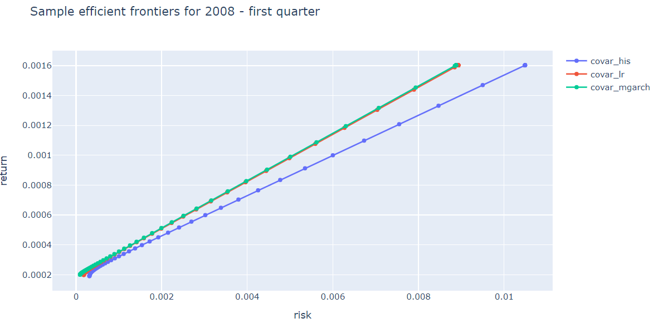
Sample Efficient frontiers

Slide 22
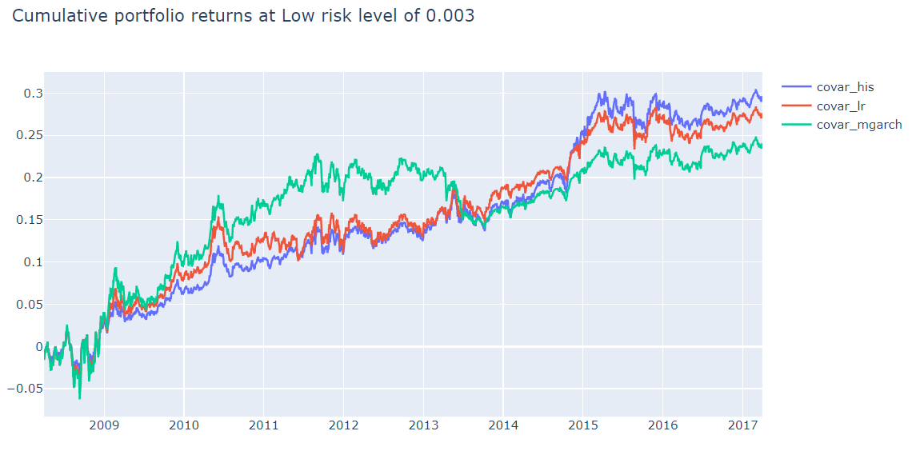
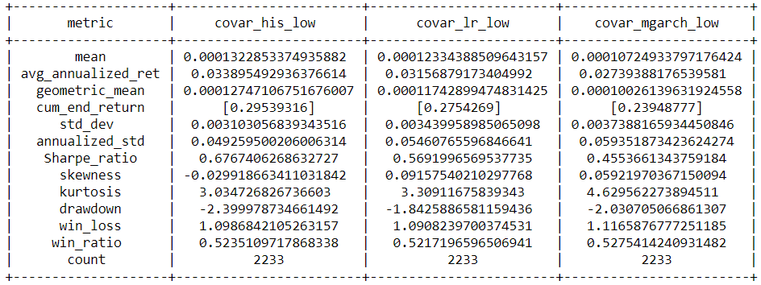
Comparing results for low risk level – 0.003

Slide 23
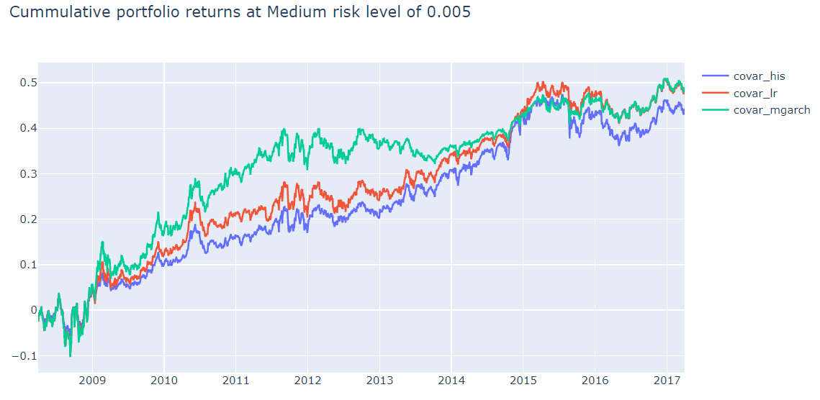
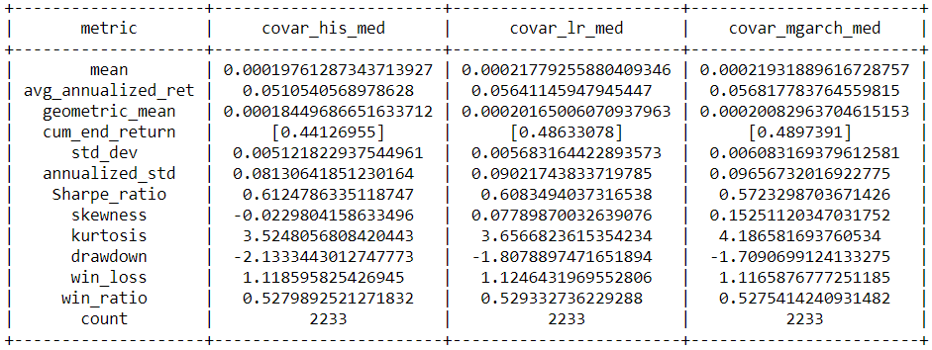
Comparing results for medium risk level – 0.005

Slide 24
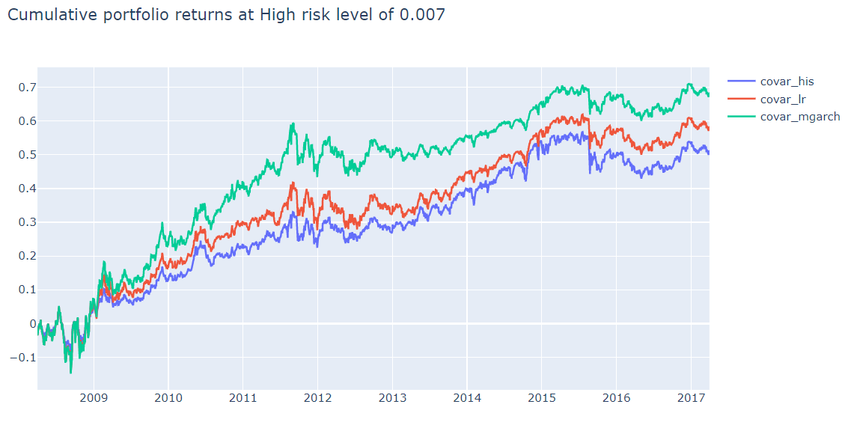
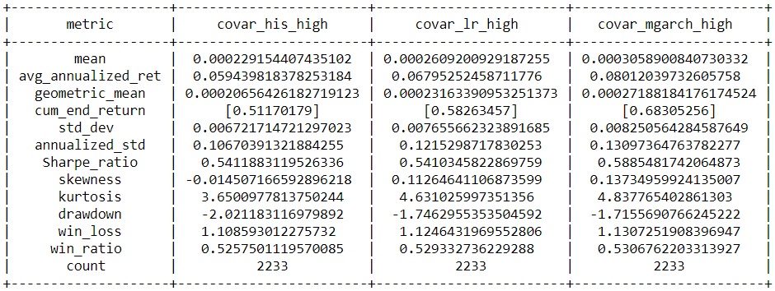
Comparing results for high risk level – 0.007

Slide 25
Abir

Slide 26
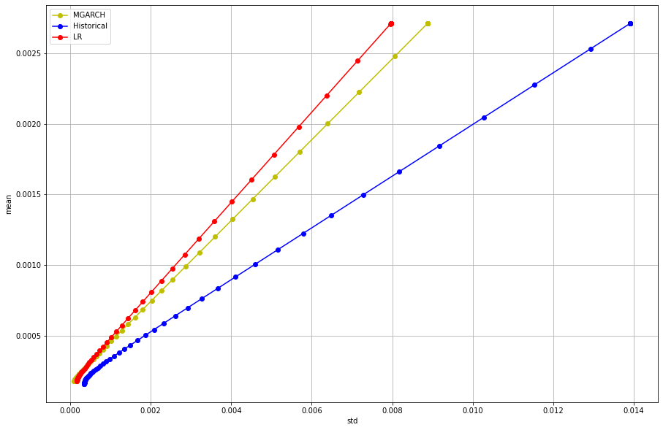
Sample Efficient frontiers(for Quarter ending 2008-03-31)

Slide 27
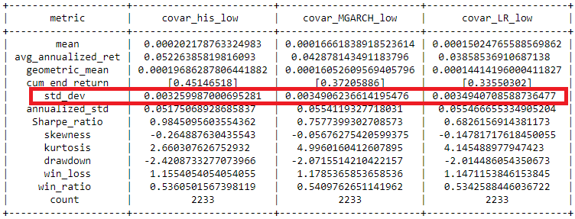
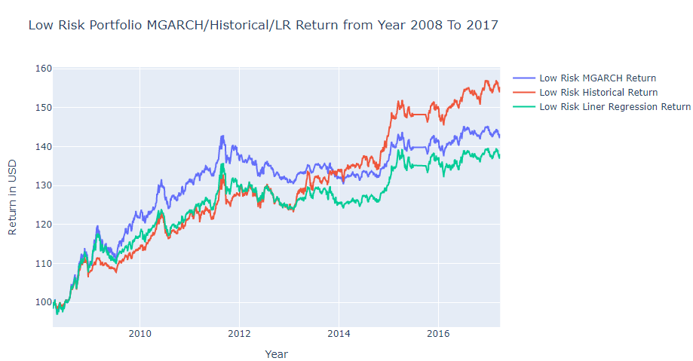
Results for low level risk – 0.003 - 63 Days Lookback

Slide 28
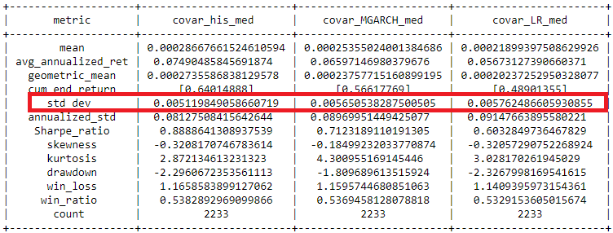
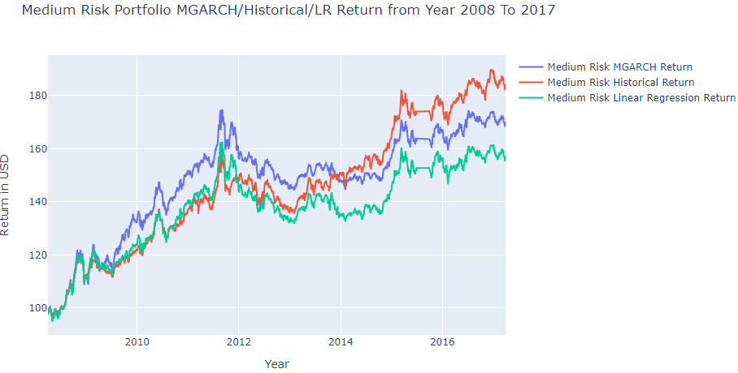
Results for Medium level risk – 0.005 - 63 Days Lookback

Slide 29
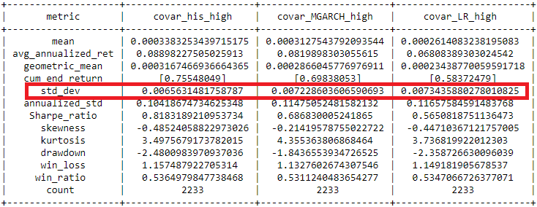
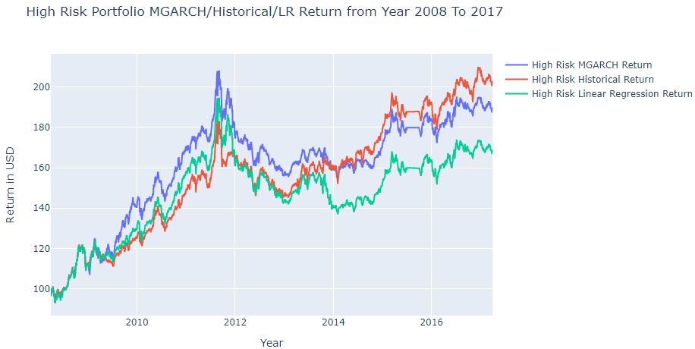
Results for High level risk – 0.007- 63 Days Lookback

Slide 30
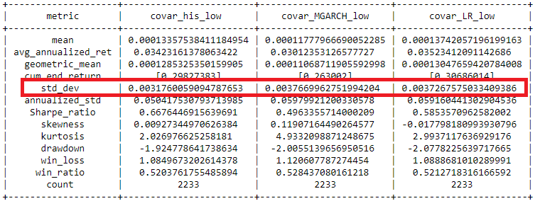
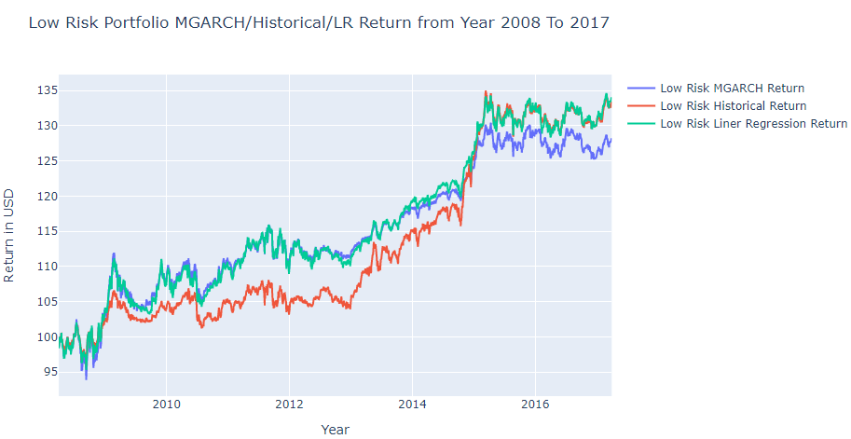
Results for low level risk – 0.003 - 252 Days Lookback

Slide 31
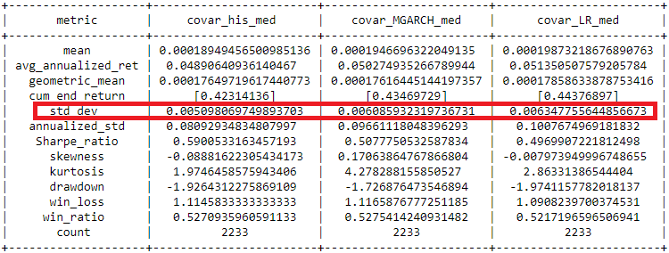
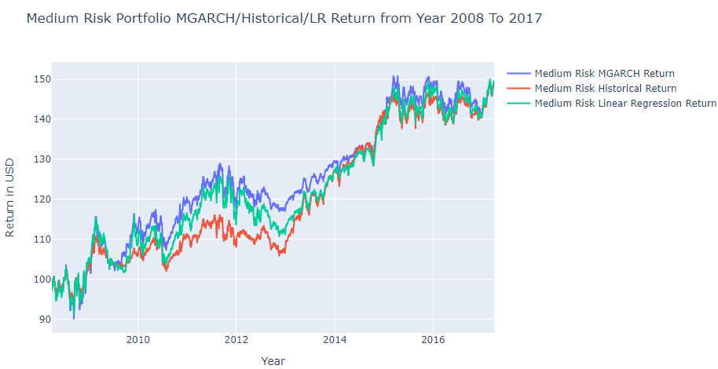
Results for Medium level risk – 0.005 - 252 Days Lookback

Slide 32
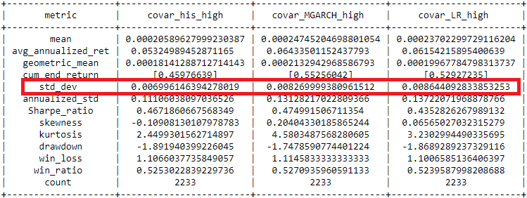
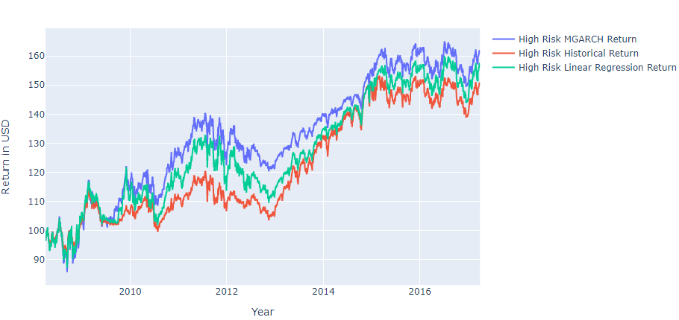
Results for High level risk – 0.007- 252 Days Lookback

Slide 33
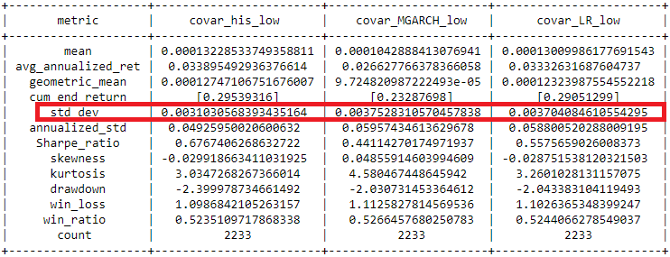
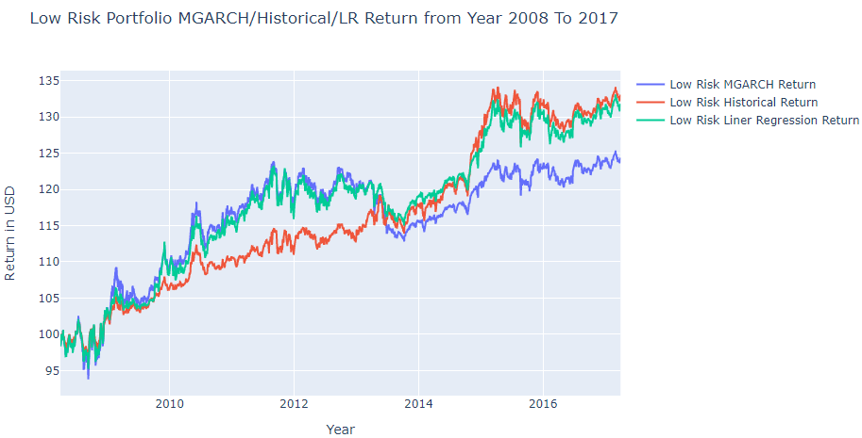
Results for low level risk – 0.003 - 504 Days Lookback

Slide 34
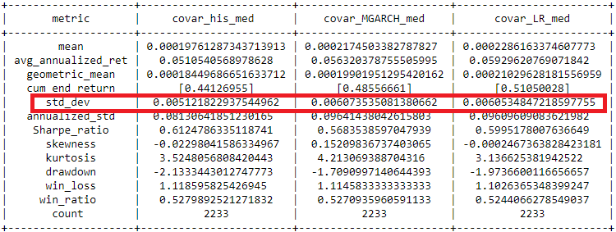
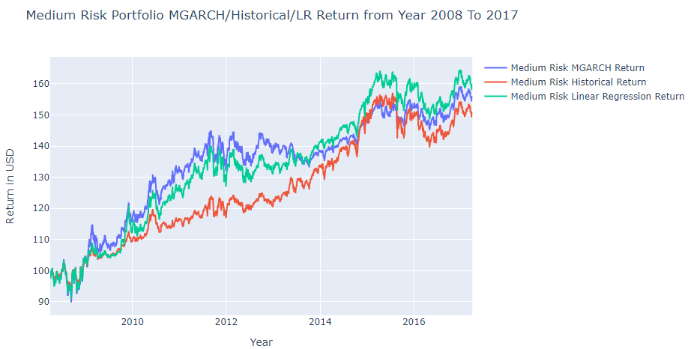
Results for Medium level risk – 0.005 - 504 Days Lookback

Slide 35
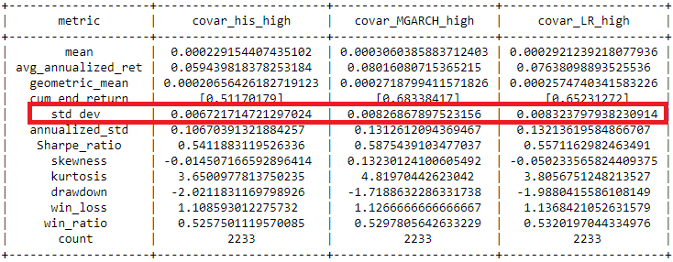
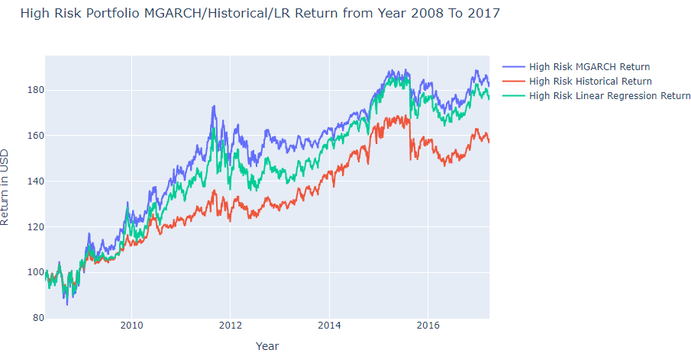
Results for High level risk – 0.007- 504 Days Lookback

Slide 36
Next steps
Construct a regime-switching model and derive regime dependent covariances and correlations
Compare portfolio returns computed using covariances from the regime-switching model

